Slide 1

Predicting IMDb Show Popularity Using Machine Learning

Slide 2
An In-Depth Analysis
Your Name: Guy Yarhi
Cycle: DS17 - 2024

Slide 3
By leveraging machine learning to predict the popularity of TV shows, we can transform vast amounts of data into actionable insights.
It enables content creators to tailor their productions to audience preferences and maximize viewer engagement.
Introduction
Notes:
What are we trying to find out? We aim to understand and predict the popularity of different entities (e.g., movies, products) based on various features. The primary question is:
What factors most significantly influence the popularity of these entities? By analyzing these factors, we seek to develop a predictive model that can forecast popularity with high accuracy.
There is no reference to time series but static data, categorial .

Slide 4
Develop Predictive Models: Create models to predict IMDb ratings using categorical features.
Feature Importance Analysis: Identify key categorical features influencing TV show popularity.
Audience Segmentation: Segment viewers based on categorical preferences and behaviors.
Content Optimization: Provide insights to optimize shows for better ratings.
User Engagement: Integrate predictions into a recommendation system.
Genre-Specific Insights: Predict popularity within specific genres.
Objective

Slide 5
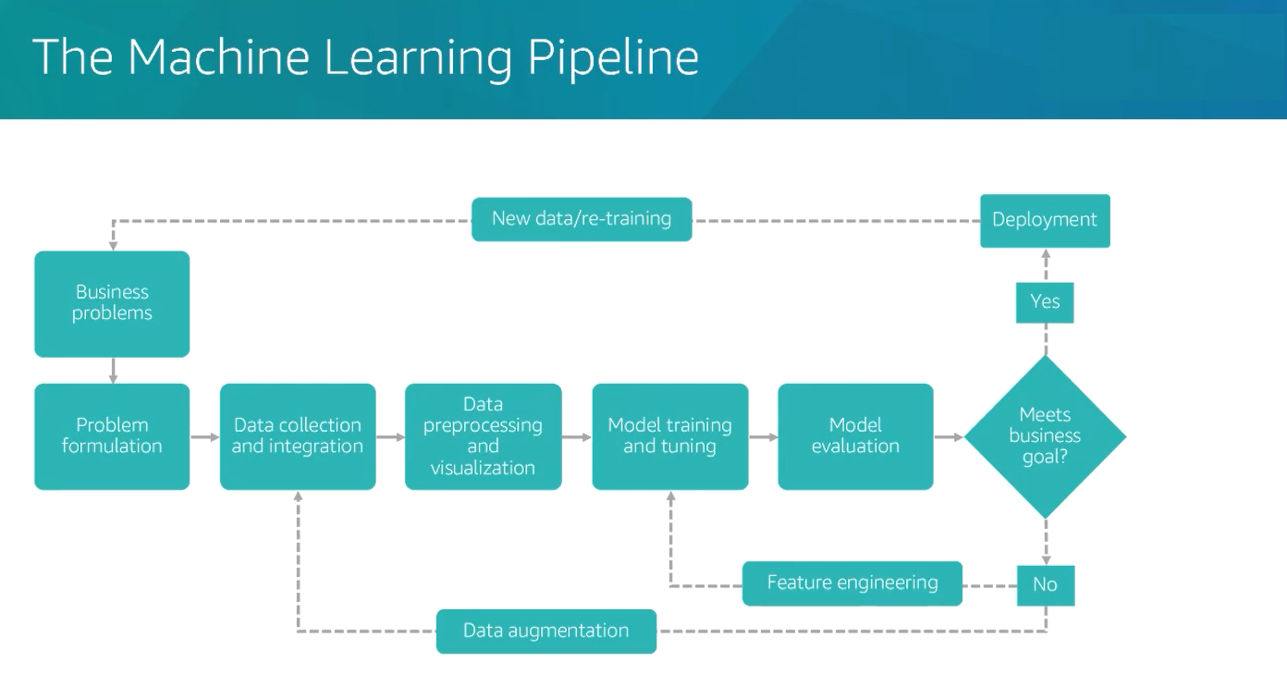
Steps toward the model

Slide 6
Raw data
The Database:
“Full TMDb TV Shows Dataset 2024 (150K Shows)”
TMDB = ‘The Movie Database’ - Database of world-wide Movies and TV shows going back to 1917
Shape = 29 columns (2 x dates, 4 x int, 2 x float, 2 x boolean, 8 x string, 11 x categories) x 168640 rows
Important columns:
Id (int), Name (string) = Identify the TV Show.
Number of Seasons (int), Number of Episodes (int) , episodes_run_time (int) – how long have the show been on the air and how long is the show
Original language (cat), languages (cat), spoken_languages (cat) = The original language (string), current languages (list), spken_languages (list) of the show
Vote-avg. (float) = Avg. vote rating for the TV show
Overview (string) = Overview or plot summary of the TV show.
Adult (Boolean), in_production (Boolean) = indicate if the TV_show is classified as Adult and whether it is currently in production
First Air Date (date), Last Air Date (date) = first aired and last aired
production_companies (string), networks (string) - who is producing the show and in which network you can see it
Genres (cat) – what is the show gener
Target = ‘Popularity’ column:
Float64
Min 0. No real Max (in DB 3707) - score can increase indefinitely depending on engagement with TV-show.
Notes:
Some features were removed due to NAN Of above 70%.
The target feature is imputed on its missing data. ( no other change can be made to the target feature except this)
Perform an LLM search for cross-validation of other features. Some were removed and some were updated.
Perform integrity data or invalid data via some cross-checking.
Enhanced the feature if needed and remove redundant features.
All are described in the notebook of the first and third notebooks : United and cleaning, cleansing.

Slide 7
Steps toward Model
Data Preparation:
Goal: Ensure that the data is ready for analysis by standardizing and unifying it.
EDA – Explanatory Data Analysis(dataprep):
Goal: Understand the data’s structure and patterns to inform further analysis.
Data Cleansing – Outliers and Missing Values(IQR, Imputation):
Goal: Improve data quality and model accuracy by addressing data inconsistencies.
One Hot Encoding (get dummies or labeling):
Goal: Prepare categorical data for machine learning models.
Feature Engineering – Adding Features (Lasso on numeric, Random Forest on categorial):
Goal: Enhance model performance by incorporating relevant features and reducing dimensionality.
Imbalanced Data – When Relevant – (Not relevant here):
Goal: Ensure the model performs well across all classes.
Model Selection and Fine-Tuning (gridsearch):
Goal: Optimize model performance to achieve the best predictive accuracy.
Notes:
1. Feature Selection Without Encoding
While most feature selection methods require numerical data, there are some techniques that can handle categorical data directly:
Tree-Based Methods: Algorithms like Decision Trees, Random Forests, and Gradient Boosting can handle categorical data without explicit encoding. These methods can split on categorical features directly².
Chi-Square Test: For categorical input and output, the Chi-Square test can be used to determine the independence of features. This method evaluates the relationship between categorical variables and the target variable².
Mutual Information: This method can be used for both categorical and numerical data. It measures the dependency between variables and can be used for feature selection².
2. Feature selection techniques that cannot handle categorical data directly:
Pearson’s Correlation
ANOVA (Analysis of Variance)
Recursive Feature Elimination (RFE)
Lasso Regression (L1 Regularization)
Ridge Regression (L2 Regularization)
Principal Component Analysis (PCA)
Linear Discriminant Analysis (LDA)
3.Imbalanced Data
refers to a situation in machine learning where the number of observations in different classes is not equal. This is common in classification problems where one class (the majority class) has significantly more samples than the other class (the minority class). For example, in a fraud detection dataset, fraudulent transactions are much rarer than legitimate ones.
here are several techniques to handle imbalanced data:
Resampling Methods: Such as oversampling the minority class or undersampling the majority class.
Algorithmic Approaches: Using algorithms that are robust to imbalanced data, like tree-based methods.
Synthetic Data Generation: Techniques like SMOTE (Synthetic Minority Over-sampling Technique) to generate synthetic samples for the minority class
Cleansing :
Outliers and missing values visualization, Identify outliers (IQR or Z-score), Remove outliers, Imputation (reliable source, new categories, KNN, MICE), Visual representation of imputation, Save updated DataFrame

Slide 8
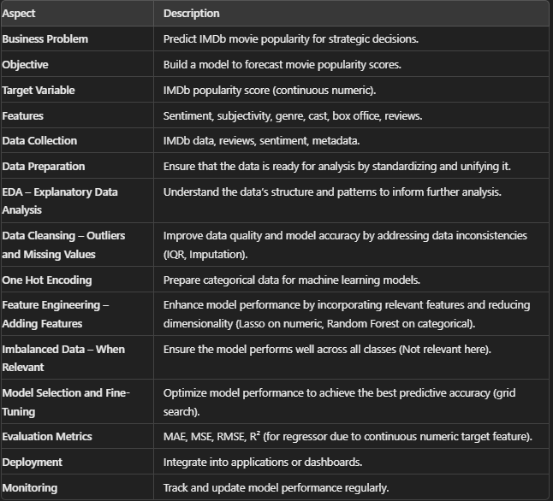
Steps toward Model
.
Notes:
1. Feature Selection Without Encoding
While most feature selection methods require numerical data, there are some techniques that can handle categorical data directly:
Tree-Based Methods: Algorithms like Decision Trees, Random Forests, and Gradient Boosting can handle categorical data without explicit encoding. These methods can split on categorical features directly².
Chi-Square Test: For categorical input and output, the Chi-Square test can be used to determine the independence of features. This method evaluates the relationship between categorical variables and the target variable².
Mutual Information: This method can be used for both categorical and numerical data. It measures the dependency between variables and can be used for feature selection².
2. Feature selection techniques that cannot handle categorical data directly:
Pearson’s Correlation
ANOVA (Analysis of Variance)
Recursive Feature Elimination (RFE)
Lasso Regression (L1 Regularization)
Ridge Regression (L2 Regularization)
Principal Component Analysis (PCA)
Linear Discriminant Analysis (LDA)
3.Imbalanced Data
refers to a situation in machine learning where the number of observations in different classes is not equal. This is common in classification problems where one class (the majority class) has significantly more samples than the other class (the minority class). For example, in a fraud detection dataset, fraudulent transactions are much rarer than legitimate ones.
here are several techniques to handle imbalanced data:
Resampling Methods: Such as oversampling the minority class or undersampling the majority class.
Algorithmic Approaches: Using algorithms that are robust to imbalanced data, like tree-based methods.
Synthetic Data Generation: Techniques like SMOTE (Synthetic Minority Over-sampling Technique) to generate synthetic samples for the minority class.

Slide 9
Data Preparations
Combine tables, Data type conversion.
Reduce broad categories, Standardize terms.
Remove single-value columns.
Clean punctuation.
Verify column accuracy,
Flat file preparation.
Flat file is ready.

Slide 10
EDA
Save data metrics.
Generate automated report.
Data description.
Statistical metrics, Visualizations.
Target variable description.
Relationships between data

Slide 11
EDA Insights
90% of items are translated into English.
90% of items are not adult items.
Generally, Less season is more popular.
Data Perspective:
Analyzing movie popularity by origin country can reveal that genres resonate well with audiences from specific countries, beyond continental influences.

Slide 12
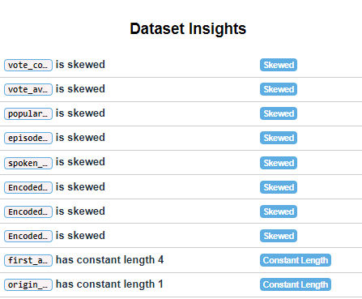
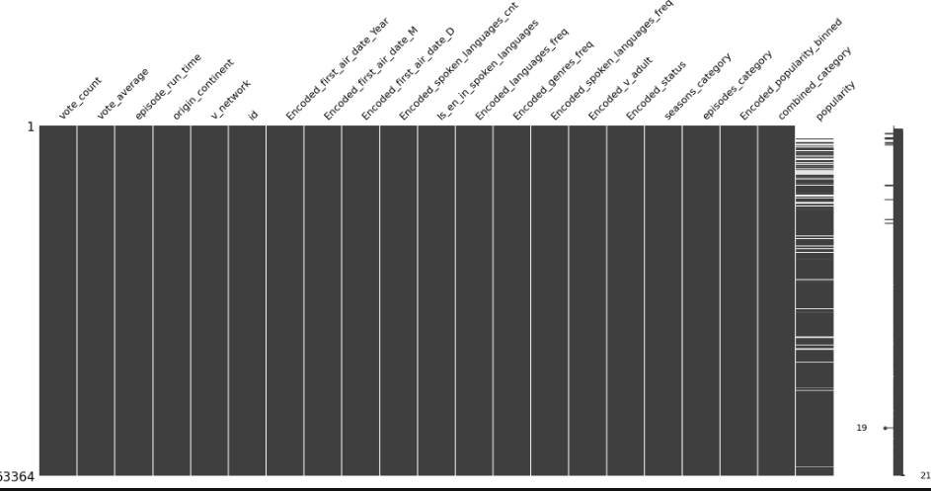
Data Analysis

Slide 13
Steps toward the model
General Approach for Data Preprocessing and Model Training
Identify Data Type and Distribution: Determine if your data is continuous and whether it follows a normal or non-normal distribution, or if it is categorical and whether it is ordinal or Nominal (discrete\ non-ordinal) .
Imputation Method: Choose the appropriate imputation method based on your data type and distribution.
Feature Selection Method: Pick the best feature selection method considering your data type and target feature.
Model Training: Select the most suitable algorithms for your data type and target feature.

Slide 14
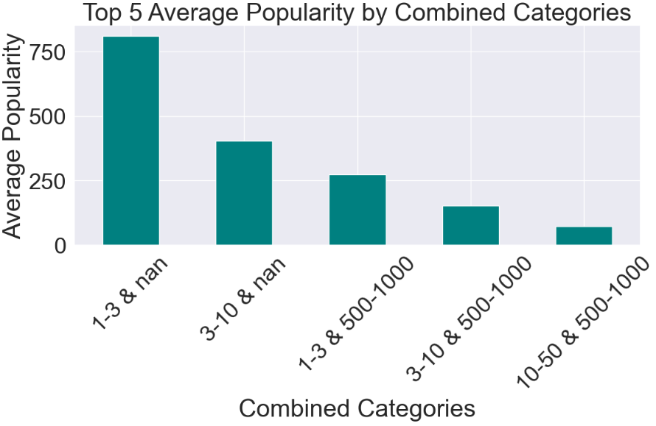
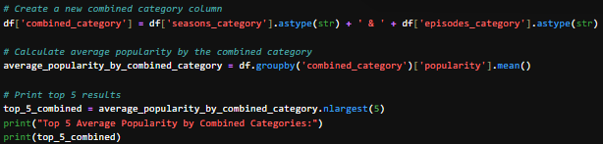
EDA
Generally, Less season is more popular

Slide 15
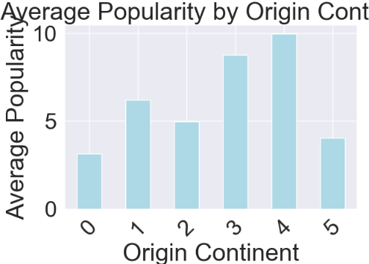
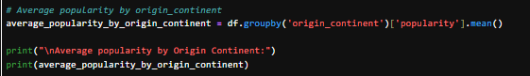
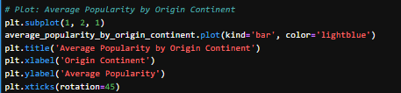
EDA
We found that genres like:
Action & Adventure,
Drama,
Crime,
Sci-Fi & Fantasy
are the most popular.

Slide 16

Build the Lego Blocks Toward Model.

Slide 17
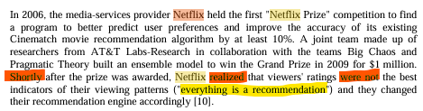
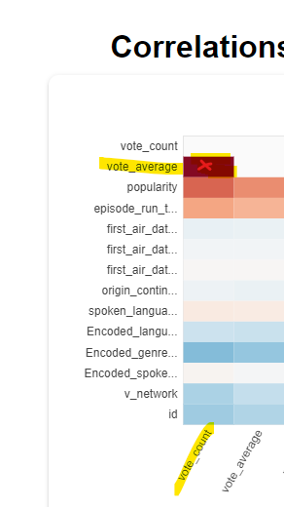

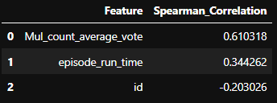
FE:
Netflix paid 1M$ for a group of sciences for model that was changed.
Notes:
Due to rejection of calc. popularity part of feature Eng. - A new Finding: time series can influence the model from text that is not describes well.
It can’t describe the complexity of time only static features or marketing.
Therefore, Convert time columns to categorial. Time series was yet not learned.

Slide 18
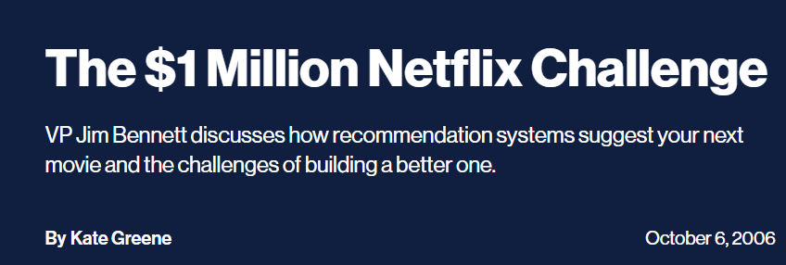
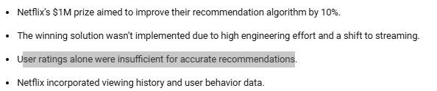



FE: Case Study: Enhancing Netflix’s Recommendation Sys.
Netflix paid 1M$ for a group of sciences for model that was changed.
Link
Notes:
Due to rejection of calc. popularity part of feature Eng. - A new Finding: time series can influence the model from text that is not describes well.
It can’t describe the complexity of time only static features or marketing.
Therefore, Convert time columns to categorial. Time series was yet not learned.

Slide 19
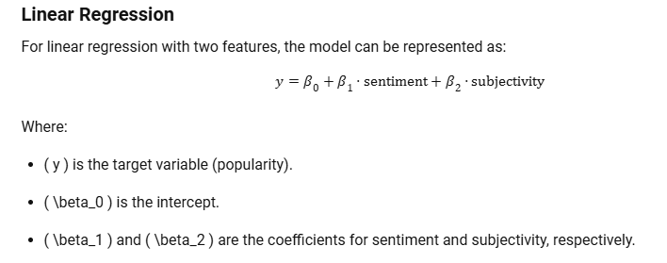
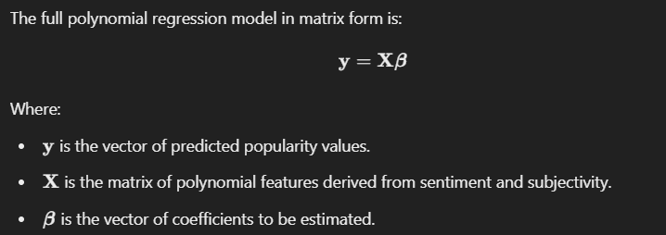
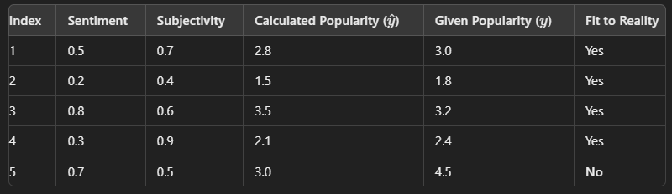
FE: Calculated popularity Vs. Given Popularity
Can’t use this model on feature eng.
Notes:
Due to rejection of calc. popularity part of feature Eng. - A new Finding: time series can influence the model from text that is not describes well.
It can’t describe the complexity of time only static features or marketing.
Therefore, Convert time columns to categorial. Time series was yet not learned.

Slide 20
The path to best model
What are we aiming to achieve?
Success for this project involves creating a predictive model that accurately forecasts popularity. We define success as:
Achieving a high level of accuracy, measured by metrics such as MAE, MSE, and RMSE.
Identifying key factors that significantly impact popularity.
Providing actionable insights that can inform strategies to enhance popularity.
Provide predictive Model.

Slide 21
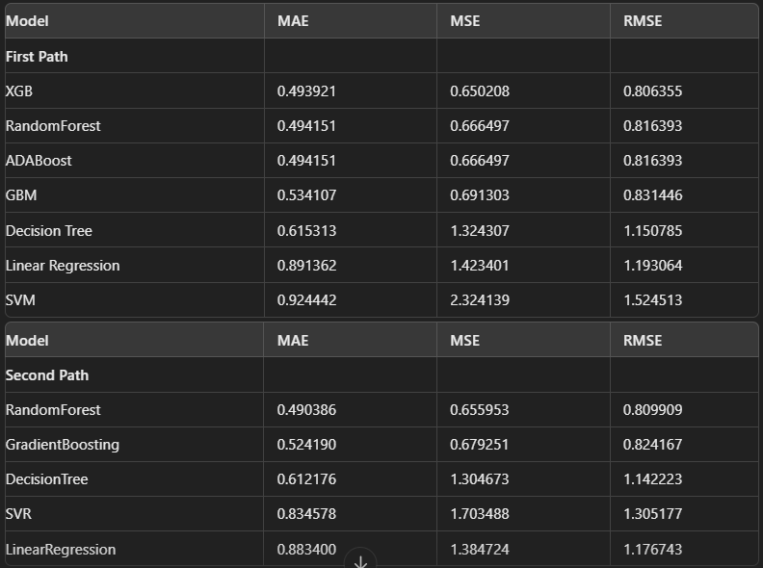
Results – Two Path
Notes:
Pearson Correlation: Measures the linear relationship between two continuous (numeric) variables. It assumes that the data is normally distributed and is sensitive to outliers.
Spearman Correlation: Measures the strength and direction of the monotonic relationship between two variables. It can be used with ordinal (categorical) data or continuous data that does not necessarily follow a normal distribution. It is less sensitive to outliers.
use non-parametric methods. Here are two common approaches:
Spearman’s Rank Correlation: Measures the strength and direction of the monotonic relationship between two variables. It works well with ordinal data or continuous data that doesn’t follow a normal distribution and is less sensitive to outliers.
Kendall’s Tau: Another non-parametric method that measures the strength and direction of association between two variables. It is particularly useful for small sample sizes and is robust to outliers.
Outlier are done only for continues numeric – normal – z score , none normal IQR 1.5 range.

Slide 22
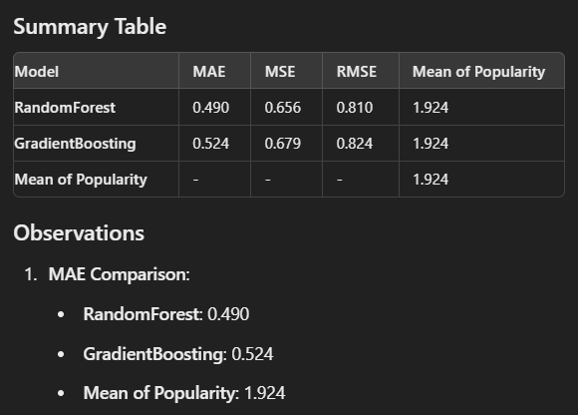
Model performance comparison – Regressor:

Slide 23
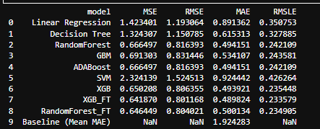
Fine-tuning for the best model – Regressor:
We expect ~ 5% Improvement in performance.

Slide 24
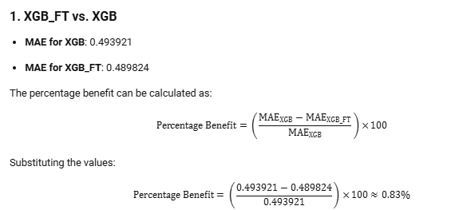
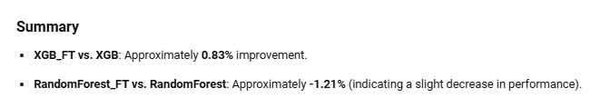
Fine-tuning for the best model – Regressor:

Slide 25


Thank You

